Slide 1
Introduction to Variant calling analysis
Detection of small variants (i.e., SNPs, Indels, Deletions) in Whole-Exome/-Genome Sequencing data

Slide 2
Exome & Whole-genome Sequencing
Whole-exome Sequencing (WES) is a method that enables the selective sequencing of the exonic regions of a genome (i.e., mRNAs & UTRs)
~180.000 exons in human genome, representing only ~1% but harboring up to 85% of all disease-causing variants (Choi et al., 2009)
Whole-genome Sequencing (WGS) encompasses the entire length of the genome
WES vs WGS:
WGS provides more data but requires additional time to process
WES captures most information in a cost-effective way
WGS more suitable for Copy-number variation (CNV) analysis
Notably, the costs of WES may actually not be higher even today than the costs of conventional genetic testing (Vissers et al., 2017)

Slide 3
In this tutorial
Raw WES data (fastq) from a family trio
The boy child (sample name: “proband”) is affected by the disease osteopetrosis
Both parents, who happen to be consanguineous, are unaffected
We will go through the steps of a typical variant calling analysis
Our goal is to identify the genetic variation that is responsible for the disease
(Optional) Explore the original workflow using Galaxy tutorial (Galaxy Europe tools only)

Slide 4
FastQ Format (doc)
FASTQ format stores sequences and Phred qualities in a single file.
It is concise and compact.
FASTQ is first widely used in the Sanger Institute and therefore we usually take the Sanger specification and the standard FASTQ format, or simply FASTQ format.
Although Solexa/Illumina read file looks pretty much like FASTQ, they are different in that the qualities are scaled differently. In the quality string, if you can see a character with its ASCII code higher than 90, probably your file is in the Solexa/Illumina format.

Slide 5
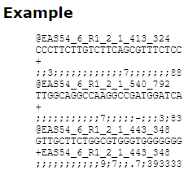
FastQ Format (doc)
Format:
@<seqname>
<sequence>
+
<quality>
Requirements
The <seqname> following '+' is optional, but if it appears right after '+', it should be identical to the <seqname> following '@’.
The length of <sequence> is identical the length of <quality>. Each character in <quality> represents the phred quality of the corresponding nucleotide in <sequence>.
The <quality> field represent the Phred quality score (non-negative integer) for each nucleotide, encoded here as a character based on the ASCII table.

Slide 6
Steps prior to Variant detection
Quality control
Trimming of low-quality and/or adapter sequences
Mapping reads to reference genome
Post-processing of mapped reads
SAM-to-BAM format conversion
Generating mapping summary statistics
Filtering reads based on SAM/BAM flags
Add information in BAM files
Mark duplicated reads
Generate reference indexes

Slide 7
Steps prior to Variant detection
Quality control
Trimming of low-quality and/or adapter sequences
Mapping reads to reference genome
Post-processing of mapped reads
SAM-to-BAM format conversion
Generating mapping summary statistics
Filtering reads based on SAM/BAM flags
Add information in BAM files
Mark duplicated reads
Generate reference indexes

Slide 8
Steps prior to Variant detection
Quality control
Trimming of low-quality and/or adapter sequences
Mapping reads to reference genome
Post-processing of mapped reads
SAM-to-BAM format conversion
Generating mapping summary statistics
Filtering reads based on SAM/BAM flags
Add information in BAM files
Mark duplicated reads
Generate reference indexes

Slide 9
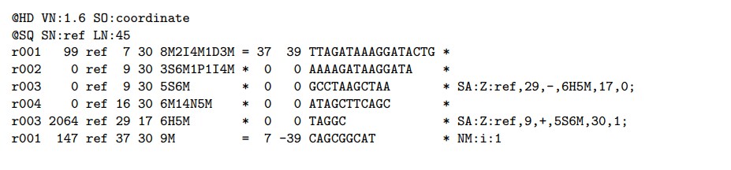
SAM & BAM format
SAM stands for Sequence Alignment/Map format.
It is a TAB-delimited text format consisting of a header section, which is optional, and an alignment section. If present, the header must be prior to the alignments.
Header lines start with ‘@’, while alignment lines do not. Each alignment line has 11 mandatory fields for essential alignment information such as mapping position, and variable number of optional fields for flexible or aligner specific information.
A BAM file (*.bam) is the compressed binary version of a SAM file that is used to represent aligned sequences up to 128 Mb.
SAM and BAM formats are described in detail at https://samtools.github.io/hts-specs/SAMv1.pdf.

Slide 10
Steps prior to Variant detection
Quality control
Trimming of low-quality and/or adapter sequences
Mapping reads to reference genome
Post-processing of mapped reads
SAM-to-BAM format conversion
Generating mapping summary statistics
Filtering reads based on SAM/BAM flags
Add information in BAM files
Mark duplicated reads
Generate reference indexes

Slide 11
Steps prior to Variant detection
Quality control
Trimming of low-quality and/or adapter sequences
Mapping reads to reference genome
Post-processing of mapped reads
SAM-to-BAM format conversion
Generating mapping summary statistics
Filtering reads based on SAM/BAM flags
Add information in BAM files
Mark duplicated reads
Generate reference indexes

Slide 12
Steps prior to Variant detection
Quality control
Trimming of low-quality and/or adapter sequences
Mapping reads to reference genome
Post-processing of mapped reads
SAM-to-BAM format conversion
Generating mapping summary statistics
Filtering reads based on SAM/BAM flags
Add information in BAM files
Mark duplicated reads
Generate reference indexes

Slide 13
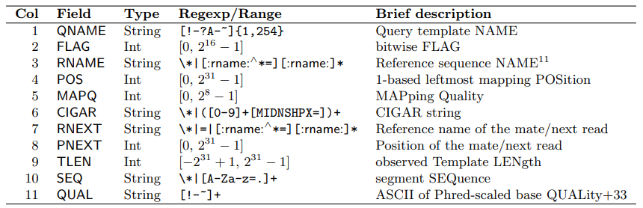
SAM & BAM format – the alignment section
https://broadinstitute.github.io/picard/explain-flags.html

Slide 14
Steps prior to Variant detection
Quality control
Trimming of low-quality and/or adapter sequences
Mapping reads to reference genome
Post-processing of mapped reads
SAM-to-BAM format conversion
Generating mapping summary statistics
Filtering reads based on SAM/BAM flags
Add sample information in BAM files
Mark duplicated reads
Generate reference indexes

Slide 15
Steps prior to Variant detection
Quality control
Trimming of low-quality and/or adapter sequences
Mapping reads to reference genome
Post-processing of mapped reads
SAM-to-BAM format conversion
Generating mapping summary statistics
Filtering reads based on SAM/BAM flags
Add information in BAM files
Mark duplicated reads
Generate reference indexes

Slide 16
Steps prior to Variant detection
Quality control
Trimming of low-quality and/or adapter sequences
Mapping reads to reference genome
Post-processing of mapped reads
SAM-to-BAM format conversion
Generating mapping summary statistics
Filtering reads based on SAM/BAM flags
Add information in BAM files
Mark duplicated reads
Generate indexes

Slide 17
Variant detection
We will use FreeBayes to call our variants
FreeBayes is a Bayesian genetic variant detector designed to find small polymorphisms, specifically SNPs (single-nucleotide polymorphisms), indels (insertions and deletions), MNPs (multi-nucleotide polymorphisms), and complex events (composite insertion and substitution events) smaller than the length of a short-read sequencing alignment
Similar software tools include:
GATK HaplotypeCaller
GATK Mutect2 (emphasis on somatic variants)
bcftools
varscan2

Slide 18
VCF format
VCF is a text file format (most likely stored in a compressed manner).
It contains meta-information lines, a header line, and then data lines each containing information about a position in the genome.
The format also has the ability to contain genotype information on samples for each position.
VCF is a preferred format because it is unambiguous, scalable and flexible, allowing extra information to be added to the info field.
Many millions of variants can be stored in a single VCF file.
More detailed information about the VCF format are available here: https://samtools.github.io/hts-specs/VCFv4.2.pdf

Slide 19
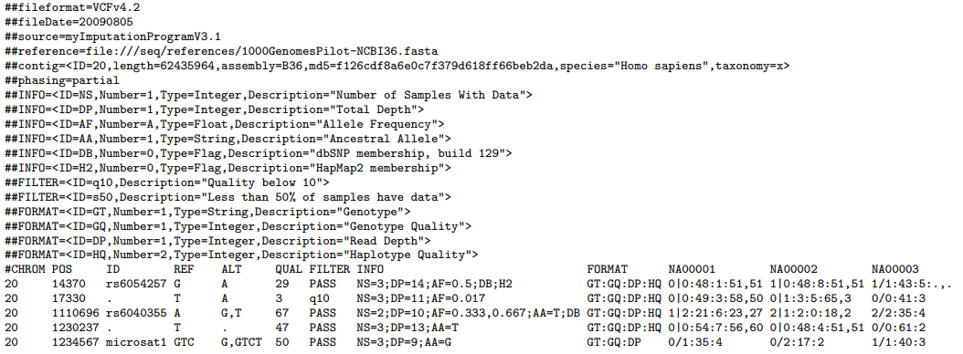
VCF format

Slide 20
Steps following Variant detection
Compress and index VCF files
Apply filters to the detected variants
Merge the VCF files of all samples
Format merged VCF files for further analysis
Annotation of the detected variants

Slide 21
Steps following Variant detection
Compress and index VCF files
Apply filters to the detected variants
Merge the VCF files of all samples
Format merged VCF files for further analysis
Annotation of the detected variants

Slide 22
Steps following Variant detection
Compress and index VCF files
Apply filters to the detected variants
Merge the VCF files of all samples
Format merged VCF files for further analysis
Annotation of the detected variants

Slide 23
Steps following Variant detection
Compress and index VCF files
Apply filters to the detected variants
Merge the VCF files of all samples
Format merged VCF files for further analysis
Annotation of the detected variants

Slide 24
Steps following Variant detection
Compress and index VCF files
Apply filters to the detected variants
Merge the VCF files of all samples
Format merged VCF files for further analysis
Annotation of the detected variants

Slide 25
Validate results - GEMINI analysis
Access GEMINI through Galaxy Europe
SQL database with annotated VCF file using GEMINI
Candidate variant detection by testing for the inheritance pattern “Autosomal recessive”
A table of candidate variants along with their respective p-values.
Mutation responsible for the phenotype in this analysis:
max_aaf_all | chrom | start | ref | alt | impact | gene | clinvar_sig | clinvar_disease_name | clinvar_gene_phenotype | rs_ids | variant_id | family_id | family_members | family_genotypes | samples | family_count
3,2489E-05 | chr8 | 86385979 | G | A | stop_gained | CA2 | None | None | carbonic_anhydrase_ii_variant|osteopetrosis_with_renal_tubular_acidosis | None | 3297 | FAM | father(father;unaffected;male),mother(mother;unaffected;female),proband(proband;affected;male) | G/A,G/A,A/A | proband | 1

Slide 26
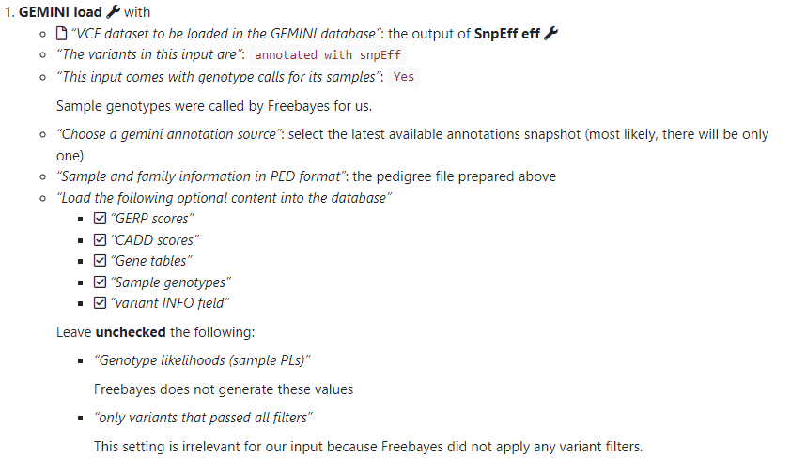
Validate results - GEMINI load

Slide 27
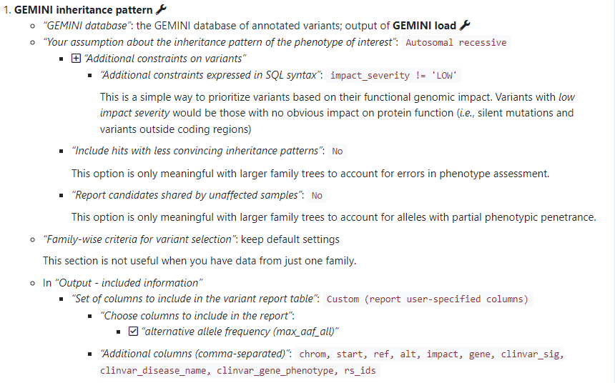
Validate results - GEMINI inheritance pattern

